Slide 1
Brand Response to COVID-19

Slide 2
Overview
Pandemic as an “external” brand crisis
Impact on consumer expectations for brands
Implications for positioning
Effective brand responses
Impact of the pandemic on brands

Slide 3
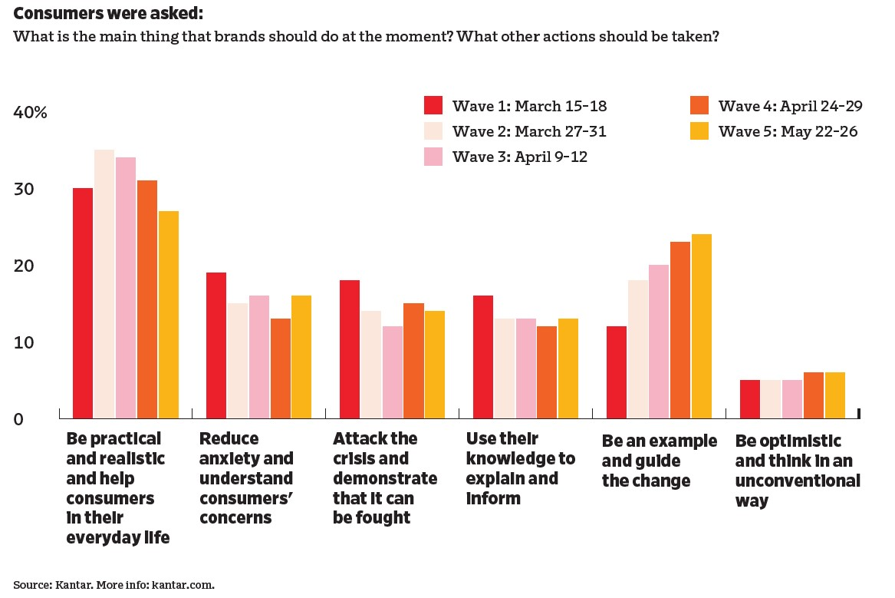
Consumer Priorities for Brands

Slide 4
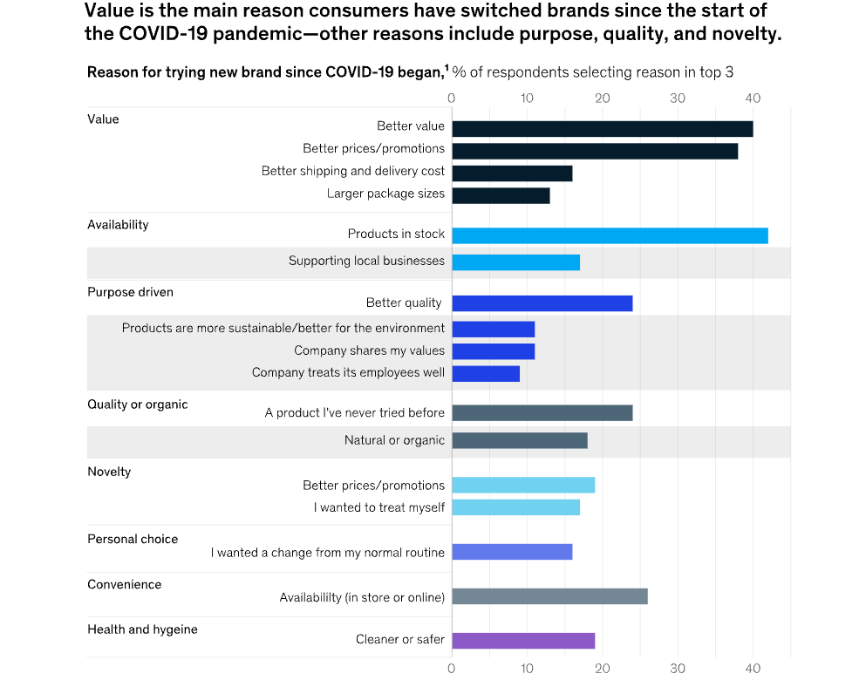
Results of a McKinsey Study

Slide 5
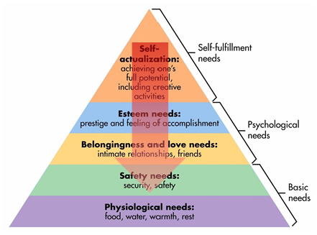
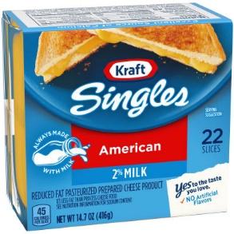
Re-Thinking the Brand Positioning Hierarchy
Personal Values
Psychological Benefits
Functional Benefits
Product Features
Concrete Product Offering
Notes:
23

Slide 6

Focus on Consumer, not Yourself

Slide 7
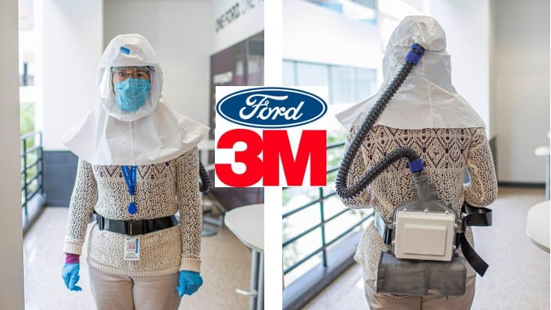

Talk is Cheap, Take Action

Slide 8


Make Employees the Heroes
“Courage is Beautiful”

Slide 9
Pandemic Effects Going Forward
Increased focus on the “basics”
Brand loyalty has deteriorated, needs prioritization
“Home” as a robust marketing opportunity
Most effects likely to be temporary
Need for rapid response readiness

Slide 10
Conclusions
How has your firm responded to COVID-19?
How have your own expectations for brands changed?

Slide 11
End of Lecture

